Slide 1

June 2020
Inside Sherpa – Digital Internship
Technology, Strategy & Innovation – TS&I
Deloitte Virtual Intern

Slide 2
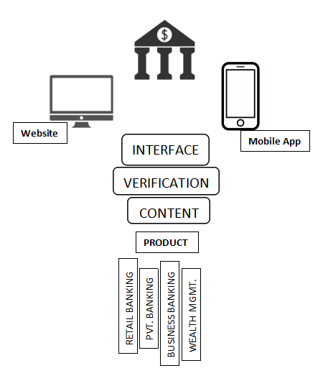
Module 1
Client Discovery
Technology Architecture
Technology Framework:
Losses attributable to operational risk are a significant factor in Comprehensive Capital Analysis and Review (CCAR) loss projections for many banks. The CCAR process has matured, with regulators and financial institutions learning from each other in an ongoing and reinforcing cycle. Initially, the greater focus was on credit and market risk. But now significant regulatory focus has shifted to operational risk.
Compatibility:
Web Brower (including Chrome, Safari, Firefox, Edge) & Opera Mobile App (Android and iOS)
Technology Delivery Channels
Branch Banking
Mobile Banking
ATM Channel of Banking
Mobile Banking or Phone Banking, Tele-Banking
Internet Banking, Online Banking, E-Banking.
Usability of the Solution
Cost - Effective
Faster & Reliable
Automated
Less Error Prone
Secure

Slide 3


Module 2
Design a Business Case
Feasibility
Technical Feasibility Economic Feasibility Operational Feasibility Legal Feasibility
Value Analysis
Value Chain Analytics Tool (VCAT) underpins Deloitte's approach to helping companies holistically review their value chain and begin to assess alignment with current transfer pricing arrangements. This innovative technology creates a context to begin pricing transactions between entities by assessing the relative contributions made by each entity to the overall business.
Benefits

Slide 4
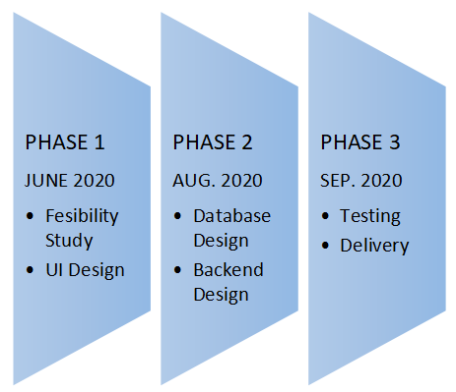
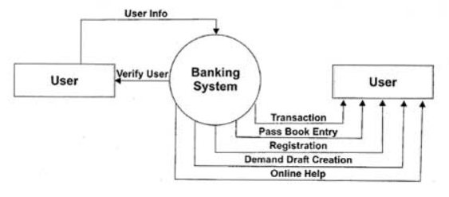
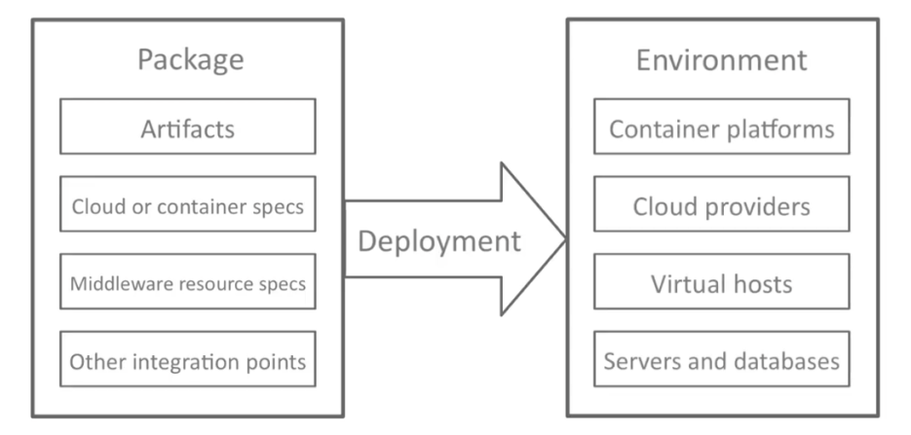
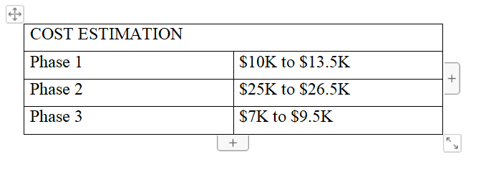
Module 3
Considerations for Mobilisation
Timeframes
Resource Requirements
Delivery Approach
Cost Estimates

